Slide 1

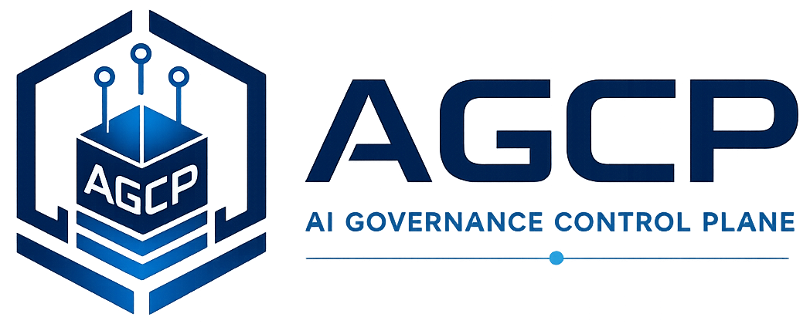
Runtime Governance Reading Series
AGCP
A Deterministic Execution-Layer Governance Control Plane for Autonomous and Programmatic Systems
Willis, J. M. (2026). AGCP: A Deterministic Execution-Layer Governance Control Plane for Autonomous and Programmatic Systems. Sustainable Future Tech, Inc. https://doi.org/10.5281/zenodo.19323672
AGCP.ai
Notes:
Voiceover script:
This module introduces the Artificial Intelligence Governance Control Plane, or AGCP, as a deterministic execution-layer approach to governing autonomous and programmatic systems. The paper is concerned with the moment when a proposed action is no longer just an intention, instruction, or workflow step, but is about to become an operational state change. As you read, pay attention to the paper's repeated separation of proposal, evaluation, authorization, and commit. That separation is the foundation for making AI actions inspectable, reproducible, and governable rather than merely logged after the fact.

Slide 2
Why this problem matters
AGCP Control Plane
• Autonomous and programmatic systems can propose operational mutations at machine speed.
• Identity, policy, and workflow tools do not by themselves define commit-time state-transition governance.
• A deterministic control plane can make governance decisions reproducible.
AGCP.ai
AGCP Control Plane
01
Notes:
Voiceover script:
This problem matters because autonomous and programmatic systems can propose changes much faster than humans can review them one at a time. A tool call, workflow step, or agent decision may affect infrastructure, data, accounts, or business state. Ordinary identity and policy tools help, but they do not by themselves define a deterministic governance path for each specific state transition. AGCP focuses on that missing execution layer. The core claim is that governance should be reproducible: the same proposal, context, qualified state, and policy inputs should yield the same governance outcome.

Slide 3
The problem the paper addresses
AGCP Control Plane
• The paper addresses how to govern state-changing actions before they become operationally reachable.
• It targets TOCTOU gaps, race conditions, mutable workflow state, and non-reproducible outcomes.
• It requires a normative artifact model and lifecycle semantics.
AGCP.ai
AGCP Control Plane
02
Notes:
Voiceover script:
The paper addresses the problem of governing state-changing actions before they become operationally reachable. This is a stronger requirement than asking whether an actor generally has permission to perform a category of action. At runtime, the question is whether this specific proposed action is admissible under current conditions, current authority, current policy, and current lifecycle state. The paper therefore targets timing gaps, race conditions, mutable workflow state, and non-reproducible outcomes. It also requires a normative artifact model so decisions can be traced through evidence rather than reconstructed from informal logs.

Slide 4
Core concepts
AGCP Control Plane
Governed action proposal
Five-stage pipeline
Action envelope
Structural refusal
Append-only ledger
Ledger-derived lifecycle state
AGCP.ai
AGCP Control Plane
03
Notes:
Voiceover script:
The core concepts are best understood as a chain. A governed action proposal describes the requested action. The action envelope carries the proposal and related context. The five-stage pipeline validates the envelope, resolves the relevant state, evaluates governance rules, produces an authorization or refusal, and controls commitment. Structural refusal is important because some proposals should be rejected as invalid before policy evaluation even begins. The append-only ledger records governance events, and lifecycle state is derived from those ordered records rather than from mutable local memory.

Slide 5
Key architecture / model
AGCP Control Plane
AGCP defines deterministic governance as execution-time enforcement of admissible state transitions through a control plane.
Envelope
Validate
Evaluate
Authorize
Commit
• The paper organizes the problem as a sequence of controlled transformations.
• Each step preserves a different governance property.
• The model is useful because it exposes where ordinary workflows collapse governance distinctions.
AGCP.ai
AGCP Control Plane
04
Notes:
Voiceover script:
The key architecture is a deterministic control-plane model for execution-time governance. The sequence shown here is envelope, validate, evaluate, authorize, and commit. Each stage protects a different governance property. Validation protects the shape and admissibility of the request. Evaluation applies governance logic to qualified information. Authorization records the decision. Commit is the boundary where operational effect may occur. The model is useful because ordinary workflows often collapse these distinctions, treating a valid request, an approved request, and an executed action as though they were the same thing.

Slide 6
Critical distinctions
AGCP Control Plane
Term
Meaning
Permission
May actor perform a class of action?
Admissibility
May this action execute under current conditions?
Authorization artifact
Evidence of decision
Commit
Operational boundary where effect is applied
AGCP.ai
AGCP Control Plane
05
Notes:
Voiceover script:
The critical distinction is that permission, admissibility, authorization evidence, and commit are not interchangeable. Permission asks whether an actor may generally perform a kind of action. Admissibility asks whether this particular action may execute now, given current state and governance conditions. An authorization artifact is evidence that a governance decision occurred, but it is not the operational effect itself. Commit is the boundary where the effect is applied. AGCP is organized around keeping those distinctions explicit, testable, and auditable.

Slide 7
Worked example
AGCP Control Plane
• A service requests endpoint isolation.
• AGCP validates the envelope, resolves state, evaluates policy, and issues authorization or refusal.
• The execution layer may commit only if lifecycle and authorization constraints hold.
Signal
Proposal
Governance
Outcome
1
2
3
4
AGCP.ai
AGCP Control Plane
06
Notes:
Voiceover script:
Consider a service that requests endpoint isolation during a suspected compromise. The request begins as a proposal, not as execution authority. AGCP validates the action envelope, resolves the relevant governance state, evaluates the applicable policy and evidence, and then issues an authorization or refusal. If authorization is issued, the execution layer may commit only if lifecycle and authorization constraints still hold. The important point is that the governance decision travels with the action as structured evidence, and the commit point remains controlled rather than assumed.

Slide 8
What the paper contributes
AGCP Control Plane
• Defines AGCP as a concrete execution-layer governance system.
• Introduces a five-stage deterministic pipeline.
• Defines artifact, ledger, lifecycle, and commit semantics for governed actions.
AGCP.ai
AGCP Control Plane
07
Notes:
Voiceover script:
The paper's contribution is to make execution-layer governance concrete. It defines AGCP as a system model rather than merely a policy aspiration. It introduces a five-stage deterministic pipeline and ties that pipeline to artifacts, ledger records, lifecycle semantics, and commit behavior. This gives assessors and implementers a way to ask precise questions. What is the proposal? What state was used? What authority existed? What decision was made? What evidence proves that the operational effect was admissible at the moment of commitment?

Slide 9
Connection to the Runtime Governance corpus
AGCP Control Plane
• Operationalizes the Runtime Governance Architecture.
• Supplies the concrete model that later specifications and assessments test.
• Connects formal semantics to deployable governance interfaces.
PBSAI
RGA
AGCP
Semantics
Operating model
AGCP.ai
AGCP Control Plane
08
Notes:
Voiceover script:
Within the broader Runtime Governance corpus, this paper operationalizes the Runtime Governance Architecture. The architecture explains why execution-time mediation is needed; AGCP gives a concrete control-plane realization of that idea. It also connects to the formal semantics work, because lifecycle state, ordering, refusal, and replay all need precise execution meaning. Later specification and assessment materials build on these concepts by turning them into requirements, interfaces, and testable conformance expectations.

Slide 10
Implications for real AI systems
AGCP Control Plane
• AI action control should be deterministic and auditable.
• Execution systems need governance-binding checks at commit.
• Lifecycle state should derive from ordered governance records.
AGCP.ai
AGCP Control Plane
09
Notes:
Voiceover script:
For real AI systems, the implication is direct: action control should be deterministic, auditable, and tied to the commit boundary. It is not enough to log that an agent acted, or to ask afterward whether a tool call looked reasonable. Systems need governance-binding checks when the operational effect is about to occur. Lifecycle state should be derived from ordered governance records, because that makes later audit and replay possible. This is especially important when agents operate quickly, concurrently, or across multiple services.

Slide 11
Key takeaways
AGCP Control Plane
1
2
3
AGCP is about governing state transitions.
Proposal is not execution authority.
Commit-bound control is the core practical idea.
AGCP.ai
AGCP Control Plane
10
Notes:
Voiceover script:
The key takeaways are threefold. First, AGCP is about governing state transitions, not simply supervising model outputs. Second, a proposal is not execution authority; it is an input to governance evaluation. Third, commit-bound control is the practical center of the model. If governance does not bind at the point where consequences become operationally real, then the system may still have useful policy, logging, and review, but it does not yet have deterministic runtime governance in the AGCP sense.

Slide 12
Paper URL + quiz
AGCP Control Plane
Read the paper
https://doi.org/10.5281/zenodo.19323672
Take the quiz
agcp.ai/quiz-agcp-control-plane
Main site: AGCP.ai
AGCP.ai
AGCP Control Plane
11
Notes:
Voiceover script:
Use the paper DOI shown here as the stable reading link, and use A G C P dot A I as the main site for related materials. After reading, take the quiz at A G C P dot A I slash quiz dash A G C P dash control dash plane. The quiz is intended to reinforce the major distinctions in the paper: proposal versus execution, permission versus admissibility, authorization artifact versus commit, and ledger-derived lifecycle state. Those distinctions will recur throughout the Runtime Governance reading series.

