Slide 1

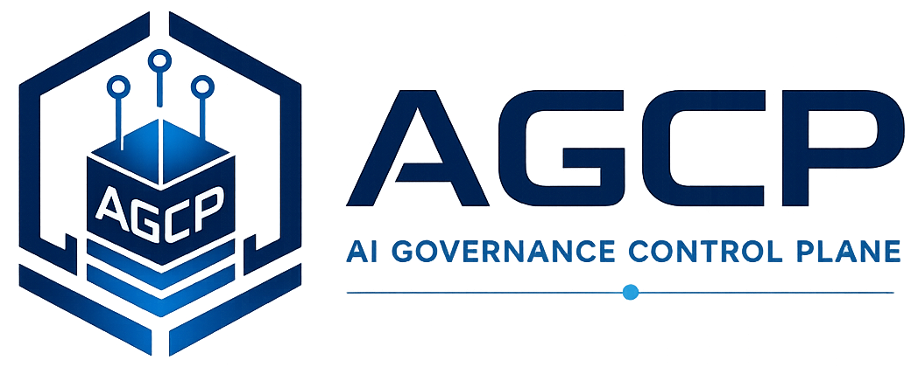
Runtime Governance Reading Series
AGCP Operating Model and Semantic Architecture
Proposal Schemas, Governance Context, Canonical State, and Commit-Bound Execution Semantics for Autonomous Systems
Willis, J. (2026). AGCP Operating Model and Semantic Architecture: Proposal Schemas, Governance Context, Canonical State, and Commit-Bound Execution Semantics for Autonomous Systems. Sustainable Future Tech, Inc. https://doi.org/10.5281/zenodo.20330062
AGCP.ai
Notes:
Voiceover script:
This module covers the AGCP Operating Model and Semantic Architecture. The focus is not simply on what a control plane does, but on what its operating artifacts mean. The paper explains how proposals, governance context, canonical state, evidence, decisions, commits, and receipts should be interpreted so that implementations do not confuse orchestration state with governance authority. As you read, look for semantic boundaries. The paper is essentially a vocabulary and contract for moving from proposed autonomous action to governed execution.

Slide 2
Why this problem matters
Operating Model
• Autonomous systems often collapse request, context, authority, state, and execution into one workflow.
• Governance requires these concepts to remain separate and inspectable.
• Semantic clarity is needed for interoperability and assessment.
AGCP.ai
Operating Model
01
Notes:
Voiceover script:
This problem matters because autonomous systems often collapse request, context, authority, state, and execution into one operational workflow. When that happens, it becomes difficult to know whether a system merely accepted a request, validated a message, evaluated policy, or authorized a state change. Runtime governance requires these meanings to remain separate and inspectable. Semantic clarity also supports interoperability. Different systems can use different internal formats, but they need equivalent governance meanings if they are to be assessed or integrated reliably.

Slide 3
The problem the paper addresses
Operating Model
• The paper addresses the operating protocol needed to move from agent proposal to governed execution.
• It defines how proposals, context, state, evidence, and receipts should be interpreted.
• It prevents orchestration state from being mistaken for governance authority.
AGCP.ai
Operating Model
02
Notes:
Voiceover script:
The paper addresses the operating protocol needed to move from agent proposal to governed execution. A proposal describes what is requested. A governance context envelope supplies information for evaluation. Canonical state identifies qualified authoritative state rather than arbitrary local state. Evidence qualification determines what information may be relied upon. A receipt records the governance outcome. The key problem is preventing ordinary orchestration state, such as a workflow status or task queue entry, from being mistaken for governance authority at the point of action.

Slide 4
Core concepts
Operating Model
Proposal schema
Governance context envelope
Canonical state
Evidence qualification
Commit-bound semantics
Governance receipt
AGCP.ai
Operating Model
03
Notes:
Voiceover script:
The core concepts define the semantic objects of AGCP operation. A proposal schema describes the requested action in controlled form. A governance context envelope carries information needed for evaluation. Canonical state is the qualified authoritative state used for governance decisions. Evidence qualification decides what supporting information is acceptable. Commit-bound semantics describe what must be true when the action becomes operational. A governance receipt makes the outcome portable and inspectable, so later systems can understand why an action was authorized, refused, or escalated.

Slide 5
Key architecture / model
Operating Model
The operating model defines the semantic contract between proposed action, governance context, canonical state, decision, and commit.
Proposal
Governance context
Canonical state
Decision
Receipt
• The paper organizes the problem as a sequence of controlled transformations.
• Each step preserves a different governance property.
• The model is useful because it exposes where ordinary workflows collapse governance distinctions.
AGCP.ai
Operating Model
04
Notes:
Voiceover script:
The key model is a semantic contract between proposed action, governance context, canonical state, decision, and receipt. Each element has a distinct role. Proposal is what is being requested. Context is what the control plane receives for evaluation. Canonical state is what the control plane treats as authoritative after qualification. Decision is the governance outcome. Receipt is the record that makes the outcome usable beyond the immediate transaction. This structure helps prevent implementations from treating validation, orchestration, and authorization as the same thing.

Slide 6
Critical distinctions
Operating Model
Term
Meaning
Proposal
What is requested
Context
Information supplied for evaluation
Canonical state
Qualified authoritative state
Receipt
Evidence of governance outcome
AGCP.ai
Operating Model
05
Notes:
Voiceover script:
The critical distinction is between what is requested, what information supports evaluation, what state is authoritative, and what evidence records the result. A proposal is not the same as context. Context is not automatically qualified state. Canonical state is not whatever the calling agent happens to believe. A receipt is not merely a log line; it is evidence of a governance outcome. These distinctions matter because runtime governance depends on knowing exactly which information controlled the decision and whether the decision remained valid at commit.

Slide 7
Worked example
Operating Model
• A containment agent submits an action proposal with evidence and policy references.
• The control plane resolves qualified state and evaluates admissibility.
• A receipt records authorization, refusal, or pending human review.
Signal
Proposal
Governance
Outcome
1
2
3
4
AGCP.ai
Operating Model
06
Notes:
Voiceover script:
Consider a containment agent that submits a proposed response action with evidence and policy references. The proposal describes the requested action. The governance context carries evidence, identity, scope, and other evaluation data. The control plane resolves qualified canonical state and evaluates admissibility. The resulting receipt records whether the action is authorized, refused, or pending human review. The important lesson is that the operating model treats the path from proposal to receipt as a governed semantic process, not just as message passing.

Slide 8
What the paper contributes
Operating Model
• Defines the semantic architecture for AGCP operating artifacts.
• Clarifies proposal, context, state, commit, and receipt boundaries.
• Provides a bridge between specifications and implementable runtime behavior.
AGCP.ai
Operating Model
07
Notes:
Voiceover script:
The paper contributes the semantic architecture for AGCP operating artifacts. It clarifies the boundaries among proposal, context, state, commit, and receipt. That matters because specifications and implementations can otherwise use similar words while implementing different governance meanings. The paper also bridges high-level architecture and implementable runtime behavior. It gives future protocols, schemas, and assessments a common conceptual target: not identical field names, but equivalent governance semantics.

Slide 9
Connection to the Runtime Governance corpus
Operating Model
• Supplies the vocabulary used by the specification, protocol, and assessment materials.
• Connects formal execution semantics to practical schemas and interfaces.
• Supports governance compilation and operating-protocol work.
PBSAI
RGA
AGCP
Semantics
Operating model
AGCP.ai
Operating Model
08
Notes:
Voiceover script:
This paper connects to the broader corpus by supplying vocabulary used by the specification, protocol, and assessment materials. The formal semantics work explains lifecycle and invariant behavior. The operating model explains the meaning of the artifacts that carry that behavior. AGCP uses these meanings in its control-plane pipeline. Governance compilation work also depends on this layer, because compiled governance artifacts must eventually produce machine-evaluable behavior that is semantically faithful to the original governance intent.

Slide 10
Implications for real AI systems
Operating Model
• Interfaces should preserve semantic distinctions explicitly.
• Implementations should avoid treating validation as authorization.
• Assessment can test whether systems demonstrate equivalent governance semantics.
AGCP.ai
Operating Model
09
Notes:
Voiceover script:
For real AI systems, the practical implication is that interfaces should preserve governance distinctions explicitly. A system should not treat a valid message as an authorized action, or a workflow state as canonical governance state. Assessment can then ask whether the implementation demonstrates equivalent semantics even if it uses different internal technologies. This is essential for multi-agent systems, where context, evidence, and authority may cross component boundaries before an action reaches an execution surface.

Slide 11
Key takeaways
Operating Model
1
2
3
Semantics are part of the governance mechanism.
Canonical state must be qualified, not assumed.
Receipts make decisions portable, inspectable, and auditable.
AGCP.ai
Operating Model
10
Notes:
Voiceover script:
The key takeaways are that semantics are part of the governance mechanism, not merely documentation. Canonical state must be qualified rather than assumed. Governance receipts make decisions portable, inspectable, and auditable. If those concepts are missing or collapsed, a system may still have useful automation, but it becomes much harder to prove that an action was admissible under the right authority, evidence, and state at the moment of execution.

Slide 12
Paper URL + quiz
Operating Model
Read the paper
https://doi.org/10.5281/zenodo.20330062
Take the quiz
agcp.ai/quiz-agcp-operating-model-semantic-architecture
Main site: AGCP.ai
AGCP.ai
Operating Model
11
Notes:
Voiceover script:
Use the DOI shown here as the stable reading link, and use A G C P dot A I for the broader Runtime Governance materials. After reading, take the quiz at A G C P dot A I slash quiz dash A G C P dash operating dash model dash semantic dash architecture. The quiz focuses on the semantic boundaries in the paper: proposal, context, canonical state, evidence qualification, commit-bound semantics, and governance receipts.

