Slide 1

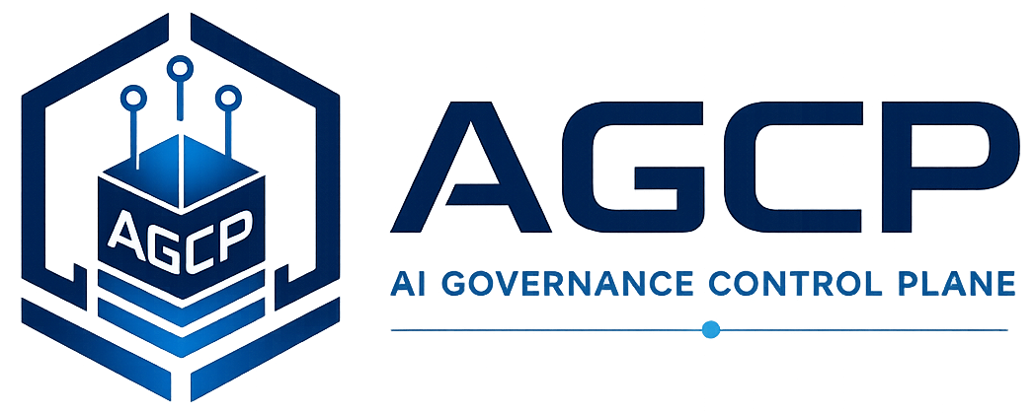
Runtime Governance Reading Series
The PBSAI Governance Ecosystem
A Multi-Agent AI Reference Architecture for Securing Enterprise AI Estates
Willis, J. M. (2026). The PBSAI Governance Ecosystem: A Multi-Agent AI Reference Architecture for Securing Enterprise AI Estates. arXiv:2602.11301. https://arxiv.org/abs/2602.11301
AGCP.ai
Notes:
Voiceover script:
This module covers the pee-be-sigh Governance Ecosystem, a multi-agent reference architecture for securing enterprise AI estates. The paper uses pee-be-sigh as the label for an architecture that organizes AI-enabled cyber defense across domains, bounded agent families, context, structured outputs, and evidence. The key point for this reading series is that multi-agent AI needs more than isolated assistants. It needs an estate-level governance structure that can produce evidence-bearing proposals for runtime governance.

Slide 2
Why this problem matters
PBSAI Governance Ecosystem
• Enterprises are deploying AI across security tooling, data pipelines, cloud platforms, and human workflows.
• Point tools and informal agent assistants do not create an estate-level governance architecture.
• Multi-agent security work needs shared context, evidence, and oversight.
AGCP.ai
PBSAI Governance Ecosystem
01
Notes:
Voiceover script:
This problem matters because enterprise AI is rapidly becoming an operational security actor, not just an advisory tool. When agents classify events, propose containment, summarize evidence, or coordinate incident response, their outputs may influence real infrastructure decisions. Without an estate-level governance model, agent activity becomes fragmented, hard to audit, and difficult to control. The paper matters because it frames AI security as a governed ecosystem problem rather than a collection of disconnected tools.

Slide 3
The problem the paper addresses
PBSAI Governance Ecosystem
• The paper addresses how to organize AI-enabled cyber defense as a governed ecosystem.
• It defines domains, bounded agent families, context envelopes, and structured output contracts.
• It separates orchestration from execution-layer governance.
AGCP.ai
PBSAI Governance Ecosystem
02
Notes:
Voiceover script:
The paper addresses the problem of how to structure AI-enabled cybersecurity across an enterprise estate. The issue is not simply whether an individual model can detect threats or generate useful analysis. The harder problem is how agents, context, outputs, evidence, and governance relationships fit together so that security operations remain accountable. The paper asks how a multi-agent security architecture can support useful automation without losing control over roles, boundaries, evidence, or consequences.

Slide 4
Core concepts
PBSAI Governance Ecosystem
AI estate
Twelve-domain taxonomy
Bounded agent families
Context envelopes
Structured output contracts
Evidence graph
AGCP.ai
PBSAI Governance Ecosystem
03
Notes:
Voiceover script:
The core concepts are domains, bounded agent families, context envelopes, structured outputs, evidence graphs, and governance handoff. Domains define where agent work occurs. Agent families keep functions and responsibilities bounded. Context envelopes carry the information needed to interpret a task. Structured outputs make agent conclusions reviewable. Evidence graphs preserve the basis for decisions. Governance handoff connects agent output to the runtime control layer that decides whether an operational consequence may occur.

Slide 5
Key architecture / model
PBSAI Governance Ecosystem
PBSAI organizes the AI security estate into governed domains and agent families that produce structured, evidence-bearing outputs.
Domains
Agents
Context
Structured output
Governance evidence
• The paper organizes the problem as a sequence of controlled transformations.
• Each step preserves a different governance property.
• The model is useful because it exposes where ordinary workflows collapse governance distinctions.
AGCP.ai
PBSAI Governance Ecosystem
04
Notes:
Voiceover script:
The key model organizes the AI security estate into governed domains and agent families that produce structured, evidence-bearing outputs. The sequence shown here is domains, agents, context, structured output, and governance evidence. This is not the same as letting agents freely coordinate actions. The architecture aims to make agent work legible. By requiring structured context and output, pee-be-sigh creates the conditions under which a runtime governance layer can evaluate proposed consequential actions before execution.

Slide 6
Critical distinctions
PBSAI Governance Ecosystem
Term
Meaning
Point AI tool
Improves a single security task
PBSAI ecosystem
Organizes roles, evidence, and governance across the estate
Agent orchestration
Coordinates work
Runtime governance
Controls operational effect
AGCP.ai
PBSAI Governance Ecosystem
05
Notes:
Voiceover script:
The critical distinction is between a point AI tool and a governed pee-be-sigh ecosystem. A point tool improves a specific task, such as detection, triage, or summarization. A pee-be-sigh ecosystem organizes roles, evidence, and governance across the enterprise estate. Another important distinction is between agent orchestration and runtime governance. Orchestration coordinates work. Runtime governance controls whether an operational effect may occur. The two can work together, but they are not substitutes for each other.

Slide 7
Worked example
PBSAI Governance Ecosystem
• A detection agent identifies suspicious endpoint behavior.
• A governance-aware agent packages evidence and proposed response.
• Runtime governance decides whether the response may become operational action.
Signal
Proposal
Governance
Outcome
1
2
3
4
AGCP.ai
PBSAI Governance Ecosystem
06
Notes:
Voiceover script:
Consider a detection agent that identifies suspicious endpoint behavior. A governance-aware agent packages the relevant evidence and proposes a response, such as containment or escalation. At that point, the proposal is still not execution authority. Runtime governance evaluates the proposed response against policy, state, evidence, and authorization. The operational response is then authorized, refused, or escalated. This example shows how pee-be-sigh can organize multi-agent cybersecurity work while A G C P-style governance controls the consequence boundary.

Slide 8
What the paper contributes
PBSAI Governance Ecosystem
• Defines a multi-agent reference architecture for enterprise AI security.
• Introduces a twelve-domain governance-aligned taxonomy.
• Shows how structured outputs and evidence graphs support oversight.
AGCP.ai
PBSAI Governance Ecosystem
07
Notes:
Voiceover script:
The paper contributes a reference architecture for thinking about enterprise AI security as an organized system. It gives language for agent families, domains, context, evidence, and outputs. It also clarifies where governance must enter the architecture. The contribution is not a single enforcement algorithm. It is an architectural framing that makes agentic security work governable by requiring structure around the work products that agents produce.

Slide 9
Connection to the Runtime Governance corpus
PBSAI Governance Ecosystem
• Provides the multi-agent cybersecurity context for runtime governance.
• Explains why AGCP must receive structured proposals from agent ecosystems.
• Connects enterprise security architecture to execution-layer control.
PBSAI
RGA
AGCP
Semantics
Operating model
AGCP.ai
PBSAI Governance Ecosystem
08
Notes:
Voiceover script:
Within the Runtime Governance corpus, pee-be-sigh provides the multi-agent cybersecurity context. It explains why a control plane such as A G C P must receive structured proposals rather than unbounded agent intentions. It also links enterprise security architecture to execution-layer control. Pee-be-sigh helps organize the upstream agent ecosystem, while runtime governance determines whether proposed consequences may become operationally real. Together, they describe both the intelligent work layer and the governance execution layer.

Slide 10
Implications for real AI systems
PBSAI Governance Ecosystem
• AI security programs should govern agent roles, evidence, and outputs, not only models.
• Multi-agent workflows need continuity across agent boundaries.
• Runtime governance can control consequences from PBSAI-organized agents.
AGCP.ai
PBSAI Governance Ecosystem
09
Notes:
Voiceover script:
For real AI systems, the implication is that AI security programs should govern agent roles, evidence, and outputs, not only models. Multi-agent workflows need continuity across agent boundaries so that context and evidence are not lost. Runtime governance can then evaluate consequences produced by pee-be-sigh-organized agents. This is especially important when agents recommend or initiate actions that affect infrastructure, users, data access, or incident response posture.

Slide 11
Key takeaways
PBSAI Governance Ecosystem
1
2
3
PBSAI organizes the governed AI estate.
Structured outputs make governance possible.
Agent ecosystems need a separate execution-control layer.
AGCP.ai
PBSAI Governance Ecosystem
10
Notes:
Voiceover script:
The key takeaways are that pee-be-sigh organizes the governed AI estate, structured outputs make governance possible, and agent ecosystems need a separate execution-control layer. A multi-agent system can be useful without being governable, and it can be well orchestrated without having deterministic runtime control. The pee-be-sigh paper addresses the first part of the problem: making the agent ecosystem structured enough that governance can evaluate its proposed actions.

Slide 12
Paper URL + quiz
PBSAI Governance Ecosystem
Read the paper
https://arxiv.org/abs/2602.11301
Take the quiz
agcp.ai/quiz-pbsai-governance-ecosystem
Main site: AGCP.ai
AGCP.ai
PBSAI Governance Ecosystem
11
Notes:
Voiceover script:
Use the archive URL shown here as the reading link, and use A G C P dot A I for related Runtime Governance materials. After reading, take the quiz at A G C P dot A I slash quiz dash P B S A I dash governance dash ecosystem. The quiz focuses on domain organization, bounded agent families, context envelopes, structured outputs, evidence graphs, and the distinction between agent orchestration and runtime governance.

