Slide 1

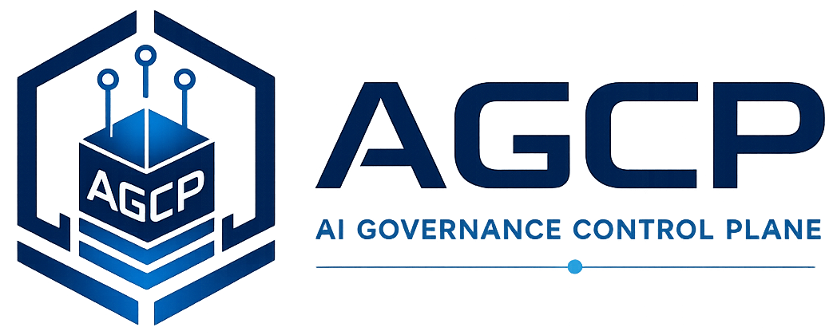
Runtime Governance Reading Series
Runtime Execution Governance for AI Systems
A Cross-Platform Synthesis and Architectural Framework
Willis, J. M. (2026). Runtime Execution Governance for AI Systems: A Cross-Platform Synthesis and Architectural Framework. Sustainable Future Tech, Inc. https://doi.org/10.5281/zenodo.19341177
AGCP.ai
Notes:
Voiceover script:
This module introduces Runtime Execution Governance for AI systems as a cross-platform architectural framework. The paper's central concern is the boundary where proposed intent becomes operational effect. As AI systems move from advice to action, governance must address not only what a model says, but what a system is about to do. This paper sets the broad thesis for the corpus: consequential action should be mediated at runtime through proposal, context, canonical state, commit, and receipt concepts.

Slide 2
Why this problem matters
Runtime Execution Governance
• AI systems are moving from advice to action.
• Tool-using agents can alter accounts, infrastructure, data, and workflows.
• Governance must operate at the boundary where proposed intent becomes effect.
AGCP.ai
Runtime Execution Governance
01
Notes:
Voiceover script:
This problem matters because AI systems are increasingly connected to tools, accounts, infrastructure, data stores, and workflows. A tool-using agent may change a configuration, revoke access, modify a record, or trigger a response. The governance problem is not only whether the model was safe in conversation. It is whether the proposed operational consequence is admissible now. Runtime execution governance focuses on the boundary where intent becomes effect, because that is where failures can become real-world system changes.

Slide 3
The problem the paper addresses
Runtime Execution Governance
• Existing controls are fragmented across AI governance, security, workflow, authorization, distributed systems, and transaction processing.
• The missing integration point is a common model for proposed consequential action.
• The paper frames runtime execution governance as an architecture problem, not a single product feature.
AGCP.ai
Runtime Execution Governance
02
Notes:
Voiceover script:
The paper addresses fragmentation across AI governance, cybersecurity, workflow systems, authorization, distributed systems, and transaction processing. Each domain has useful mechanisms, but they are often not integrated into a common model for proposed consequential action. The paper therefore frames runtime execution governance as an architecture problem. The missing integration point is a consistent way to represent a proposed action, evaluate it against context and state, and bind the governance outcome to the operational commit.

Slide 4
Core concepts
Runtime Execution Governance
Proposed consequential action
Execution governance
Commit boundary
Admissibility
Context and canonical state
Governance receipt
AGCP.ai
Runtime Execution Governance
03
Notes:
Voiceover script:
The core concepts are proposed consequential action, execution governance, commit boundary, admissibility, context and canonical state, and governance receipt. A proposed consequential action is an action that could alter some operational condition. Execution governance decides whether that action may become real. The commit boundary is where the effect is applied. Admissibility is a runtime judgment under current conditions. Context and canonical state provide the information for that judgment. The receipt records why the action was authorized, refused, or escalated.

Slide 5
Key architecture / model
Runtime Execution Governance
Runtime governance is the execution-time layer that decides whether a proposed consequential action may become operationally real.
Proposal
Context
Canonical state
Commit
Receipt
• The paper organizes the problem as a sequence of controlled transformations.
• Each step preserves a different governance property.
• The model is useful because it exposes where ordinary workflows collapse governance distinctions.
AGCP.ai
Runtime Execution Governance
04
Notes:
Voiceover script:
The key model treats runtime governance as an execution-time layer. The sequence is proposal, context, canonical state, commit, and receipt. The proposed action is submitted for governance. Context supplies information for evaluation. Canonical state identifies qualified authoritative state. Commit is the controlled boundary where the action can become operational. Receipt preserves evidence of the governance outcome. This sequence helps integrate ideas from policy systems, workflow systems, distributed transactions, and audit into a common governance architecture.

Slide 6
Critical distinctions
Runtime Execution Governance
Term
Meaning
Design governance
What a system may be built to do
Execution governance
Whether this action may execute now
Logging
What happened
Governance receipt
Why execution was admissible or refused
AGCP.ai
Runtime Execution Governance
05
Notes:
Voiceover script:
The critical distinction is between design governance and execution governance. Design governance asks what a system may be built to do. Execution governance asks whether this specific action may execute now. Another distinction is between logging and governance receipt. Logging records that something happened. A governance receipt records why execution was admissible or refused. These distinctions matter because a system can be well designed and well logged while still lacking runtime control at the point of consequential action.

Slide 7
Worked example
Runtime Execution Governance
• An agent proposes privileged account revocation after detecting anomalous activity.
• Runtime governance checks identity, evidence, policy, current incident state, and authority.
• The action is authorized, refused, or escalated before operational effect.
Signal
Proposal
Governance
Outcome
1
2
3
4
AGCP.ai
Runtime Execution Governance
06
Notes:
Voiceover script:
Consider an agent that proposes privileged account revocation after detecting anomalous activity. Runtime governance should check identity, evidence, policy, current incident state, and authority before the revocation becomes operational. The action may be authorized, refused, or escalated for human review. The key point is that the proposed response is not automatically legitimate because the agent detected something. Governance evaluates the specific action instance in context and controls whether it can cross the commit boundary.

Slide 8
What the paper contributes
Runtime Execution Governance
• Synthesizes a cross-domain property model for execution-time governance.
• Shows that many mechanisms already exist but are not architecturally integrated.
• Clarifies the proposal-context-state-commit-receipt sequence.
AGCP.ai
Runtime Execution Governance
07
Notes:
Voiceover script:
The paper contributes a cross-domain property model for execution-time governance. It shows that many mechanisms already exist in adjacent fields, but they are not usually integrated around the proposed consequential action. The paper clarifies the proposal, context, state, commit, and receipt sequence that later AGCP materials make more concrete. Its contribution is the architectural framing: runtime governance is a layer that mediates operational consequence, not a dashboard or after-the-fact review process.

Slide 9
Connection to the Runtime Governance corpus
Runtime Execution Governance
• Sets the broad thesis for the Runtime Governance corpus.
• Explains why AGCP needs proposal, state, commit, and receipt concepts.
• Connects PBSAI agent ecosystems to execution-layer control.
PBSAI
RGA
AGCP
Semantics
Operating model
AGCP.ai
Runtime Execution Governance
08
Notes:
Voiceover script:
This paper sets the broad thesis for the Runtime Governance corpus. The Runtime Governance Architecture generalizes the architectural pattern. AGCP provides a concrete control-plane realization. The operating model and formal semantics give precision to the artifacts and lifecycle. PBSAI supplies a multi-agent cybersecurity context in which agents produce proposed actions. The corpus therefore moves from problem framing, to architecture, to control-plane model, to semantics, to implementation and assessment.

Slide 10
Implications for real AI systems
Runtime Execution Governance
• System owners need action-level control, not only model-level review.
• Audit must reconstruct governance reasoning, not just event occurrence.
• Runtime controls should be designed around operational consequence.
AGCP.ai
Runtime Execution Governance
09
Notes:
Voiceover script:
For real AI systems, system owners need action-level control, not only model-level review. Audit should reconstruct governance reasoning, not merely show that an event occurred. Runtime controls should be designed around operational consequence. This means identifying the actions that can change systems, defining what context and state are required for evaluation, and binding governance outcomes to execution surfaces. These are architectural questions that should be addressed before agents are allowed to operate autonomously at scale.

Slide 11
Key takeaways
Runtime Execution Governance
1
2
3
The central risk is unauthorized or inadmissible operational effect.
Governance must bind to action instances at runtime.
The corpus treats execution governance as an architectural layer.
AGCP.ai
Runtime Execution Governance
10
Notes:
Voiceover script:
The key takeaways are that the central risk is unauthorized or inadmissible operational effect, governance must bind to action instances at runtime, and the corpus treats execution governance as an architectural layer. This is a shift from supervising prompts and outputs to governing consequential transitions. Once you see the commit boundary as the control point, the rest of the corpus becomes easier to understand.

Slide 12
Paper URL + quiz
Runtime Execution Governance
Read the paper
https://doi.org/10.5281/zenodo.19341177
Take the quiz
agcp.ai/quiz-runtime-execution-governance
Main site: AGCP.ai
AGCP.ai
Runtime Execution Governance
11
Notes:
Voiceover script:
Use the DOI shown here as the stable reading link, and use A G C P dot A I for the broader materials. After reading, take the quiz at A G C P dot A I slash quiz dash runtime dash execution dash governance. The quiz focuses on proposed consequential actions, execution governance, commit boundaries, admissibility, canonical state, and governance receipts.

