Slide 1

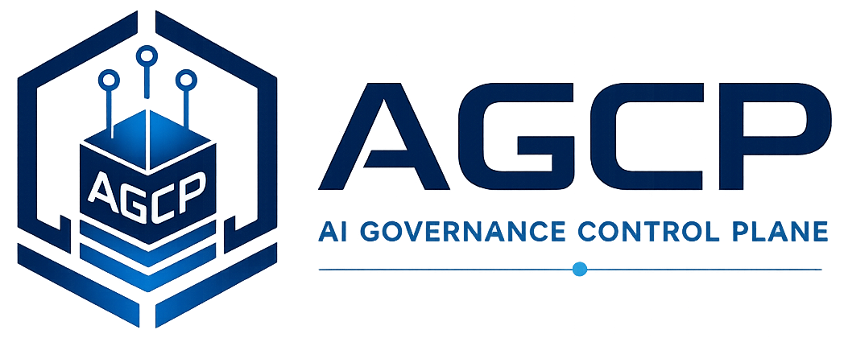
Runtime Governance Reading Series
Runtime Governance Architecture
Consistent Governance Execution for Enterprise Systems and Autonomous Agents
Willis, J. M. (2026). Runtime Governance Architecture: Consistent Governance Execution for Enterprise Systems and Autonomous Agents. Sustainable Future Tech, Inc. https://doi.org/10.5281/zenodo.19286845
AGCP.ai
Notes:
Voiceover script:
This module covers Runtime Governance Architecture, which describes consistent governance execution for enterprise systems and autonomous agents. The paper provides the architectural bridge between high-level governance concerns and a concrete control-plane design. Its central idea is that consequential actions should be mediated before execution through a governance control plane. As you read, pay attention to separation of planes, lifecycle state, governance mutation submission, and the governance ledger.

Slide 2
Why this problem matters
Runtime Governance Architecture
• Enterprise systems increasingly mix human workflows, services, and autonomous agents.
• Policy intent often exists outside the execution path.
• Governance needs consistent mediation across heterogeneous systems.
AGCP.ai
Runtime Governance Architecture
01
Notes:
Voiceover script:
This problem matters because enterprise systems increasingly combine human workflows, services, automation, and autonomous agents. Policy intent often exists outside the execution path, in documents, approvals, controls, or compliance processes. But agents and services operate in heterogeneous environments where consequences occur through APIs, workflows, infrastructure platforms, and data systems. Runtime governance architecture asks how governance can be consistently mediated across those systems, instead of relying on disconnected checks and retrospective logs.

Slide 3
The problem the paper addresses
Runtime Governance Architecture
• Traditional architectures often separate policy, orchestration, logs, and execution without a deterministic governance path.
• Agents may submit, transform, or sequence actions faster than manual oversight can evaluate.
• The architecture must preserve authority, state, evidence, and lifecycle integrity.
AGCP.ai
Runtime Governance Architecture
02
Notes:
Voiceover script:
The paper addresses the problem that traditional architectures often separate policy, orchestration, logs, and execution without a deterministic governance path. Agents may submit, transform, or sequence actions faster than manual oversight can evaluate them. The architecture must therefore preserve authority, state, evidence, and lifecycle integrity while actions move toward execution. The problem is not simply whether a policy engine exists. It is whether the overall architecture can mediate consequential action consistently before the operational effect occurs.

Slide 4
Core concepts
Runtime Governance Architecture
Governance control plane
Governance mutation submission
Evaluation pipeline
Execution plane separation
Lifecycle state
Governance ledger
AGCP.ai
Runtime Governance Architecture
03
Notes:
Voiceover script:
The core concepts are governance control plane, governance mutation submission, evaluation pipeline, execution plane separation, lifecycle state, and governance ledger. The control plane computes governance decisions. Governance mutation submission is the act of presenting a proposed change for governance. The evaluation pipeline applies governance logic. Execution plane separation keeps decisioning distinct from operational effect. Lifecycle state tracks the action's governance status. The governance ledger records events that make lifecycle and replay possible.

Slide 5
Key architecture / model
Runtime Governance Architecture
Runtime governance externalizes governance evaluation so consequential actions are mediated before execution.
Governance sources
Submission
Evaluation
Decision
Execution gate
• The paper organizes the problem as a sequence of controlled transformations.
• Each step preserves a different governance property.
• The model is useful because it exposes where ordinary workflows collapse governance distinctions.
AGCP.ai
Runtime Governance Architecture
04
Notes:
Voiceover script:
The key architecture externalizes governance evaluation so consequential actions are mediated before execution. Governance sources inform the control plane. A submission presents a proposed action. Evaluation applies the relevant authority, policy, state, and evidence. A decision is produced. Only then may an execution gate allow the effect to proceed. This structure helps make governance consistent across heterogeneous systems because the execution plane does not have to invent governance logic locally for every action type.

Slide 6
Critical distinctions
Runtime Governance Architecture
Term
Meaning
Control plane
Computes governance decisions
Execution plane
Applies operational effects
Policy check
Evaluates rules
Runtime governance
Maintains action lifecycle and admissibility
AGCP.ai
Runtime Governance Architecture
05
Notes:
Voiceover script:
The critical distinction is between control plane and execution plane. The control plane computes governance decisions. The execution plane applies operational effects. A policy check evaluates rules, but runtime governance maintains action lifecycle and admissibility across the path to execution. These distinctions matter because a system can have policies, workflows, and logs while still lacking a controlled governance path. Runtime governance is about the architecture that binds decisioning to execution outcomes.

Slide 7
Worked example
Runtime Governance Architecture
• A workflow engine asks to change cloud firewall policy.
• The governance control plane validates the submission, evaluates policy, checks state, and returns a decision.
• Only an authorized decision reaches the execution gate.
Signal
Proposal
Governance
Outcome
1
2
3
4
AGCP.ai
Runtime Governance Architecture
06
Notes:
Voiceover script:
Consider a workflow engine that asks to change a cloud firewall policy. The request should be submitted as a governed proposal rather than applied immediately. The governance control plane validates the submission, evaluates policy, checks relevant state and authority, and returns a decision. Only an authorized decision reaches the execution gate. This example shows the architectural pattern: execution systems continue to perform operational work, but they do so under governance decisions produced by a separate control plane.

Slide 8
What the paper contributes
Runtime Governance Architecture
• Introduces a general runtime governance architecture.
• Frames AGCP as a concrete control-plane realization.
• Separates governance decisioning from operational execution.
AGCP.ai
Runtime Governance Architecture
07
Notes:
Voiceover script:
The paper contributes a general runtime governance architecture. It frames AGCP as a concrete realization of that architecture and separates governance decisioning from operational execution. This separation is important because it allows governance to be consistent, auditable, and replayable across systems that may otherwise have different workflow engines, APIs, or enforcement mechanisms. The paper therefore provides a conceptual map for where the control plane belongs and what responsibilities it must carry.

Slide 9
Connection to the Runtime Governance corpus
Runtime Governance Architecture
• Bridges high-level governance thesis and AGCP-specific interface behavior.
• Provides architectural vocabulary used by later specification and assessment work.
• Links multi-agent use cases to enterprise runtime control.
PBSAI
RGA
AGCP
Semantics
Operating model
AGCP.ai
Runtime Governance Architecture
08
Notes:
Voiceover script:
This paper bridges the broad runtime execution governance thesis and AGCP-specific interface behavior. It provides architectural vocabulary used by the specification and assessment work, including control plane, execution plane, lifecycle state, governance ledger, and execution gate. It also links multi-agent use cases to enterprise runtime control. PBSAI can organize agent activity, but runtime governance architecture explains where proposed actions should be mediated before those actions affect the enterprise environment.

Slide 10
Implications for real AI systems
Runtime Governance Architecture
• Architectures should expose governance decision points explicitly.
• Execution systems need enough context to enforce decisions non-bypassably.
• Governance evidence should be produced as part of normal execution flow.
AGCP.ai
Runtime Governance Architecture
09
Notes:
Voiceover script:
For real AI systems, architectures should expose governance decision points explicitly. Execution systems need enough context to enforce decisions in a non-bypassable or at least strongly bound manner. Governance evidence should be produced as part of normal execution flow, not reconstructed manually after an incident. This suggests that system owners should inventory consequential action paths, identify execution gates, and determine where a governance control plane can mediate decisions consistently.

Slide 11
Key takeaways
Runtime Governance Architecture
1
2
3
Runtime governance is an architecture, not an after-the-fact log.
Control-plane separation enables consistency and replay.
Governance decisions must bind to execution outcomes.
AGCP.ai
Runtime Governance Architecture
10
Notes:
Voiceover script:
The key takeaways are that runtime governance is an architecture, not an after-the-fact log; control-plane separation enables consistency and replay; and governance decisions must bind to execution outcomes. The architecture is especially important for autonomous agents because they can create, transform, or sequence actions quickly. Without an explicit governance path, the system may rely on assumptions that are difficult to audit or reproduce.

Slide 12
Paper URL + quiz
Runtime Governance Architecture
Read the paper
https://doi.org/10.5281/zenodo.19286845
Take the quiz
agcp.ai/quiz-runtime-governance-architecture
Main site: AGCP.ai
AGCP.ai
Runtime Governance Architecture
11
Notes:
Voiceover script:
Use the DOI shown here as the stable reading link, and use A G C P dot A I for the broader corpus. After reading, take the quiz at A G C P dot A I slash quiz dash runtime dash governance dash architecture. The quiz focuses on control-plane separation, execution gates, governance mutation submission, lifecycle state, governance ledgers, and the difference between policy checks and runtime governance.

